Slide 1


Smart Energy Management System in Urban Areas
This project aims to improve energy efficiency in urban areas by implementing a smart energy management system. The system will monitor and control energy consumption in real-time, optimizing resource utilization.
Notes:
1

Slide 2
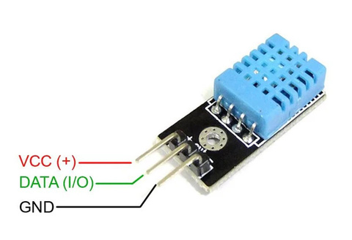
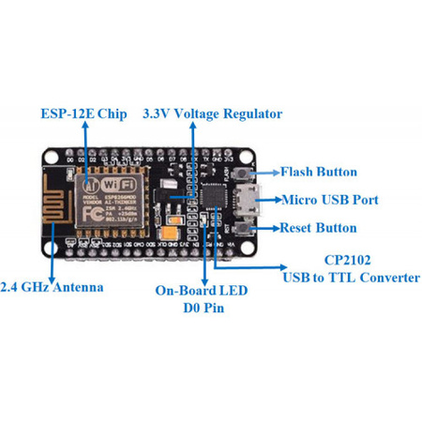
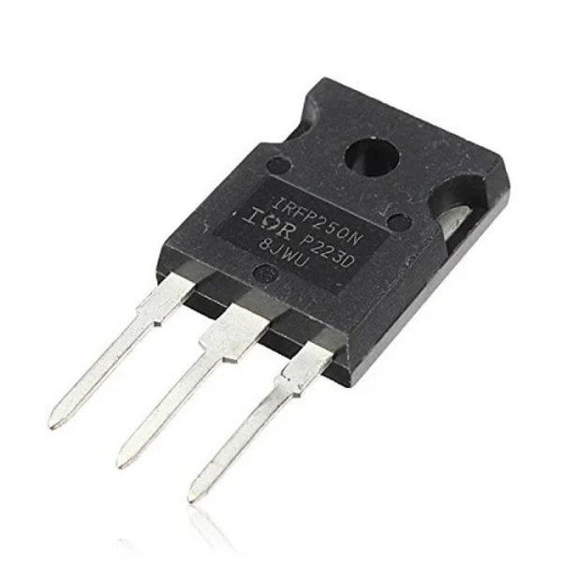
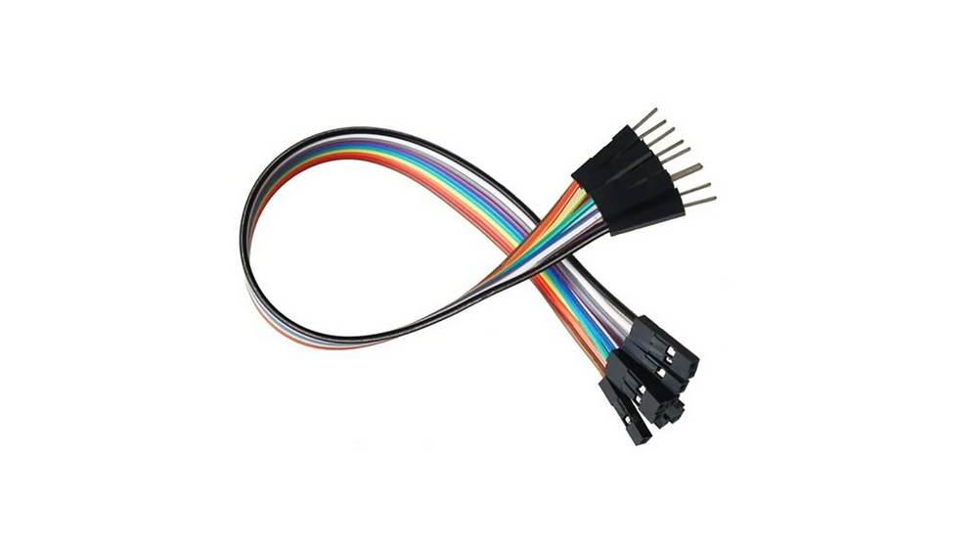
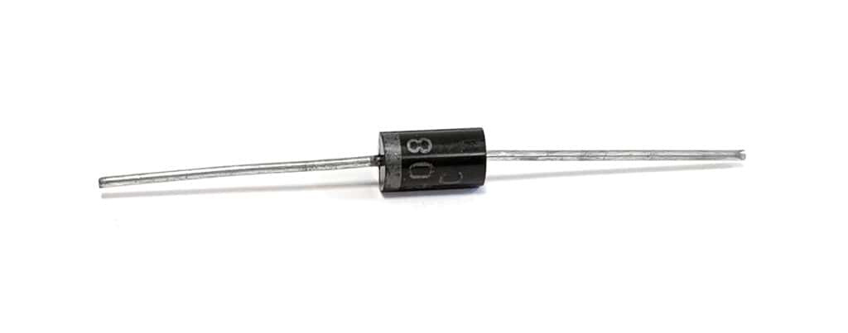
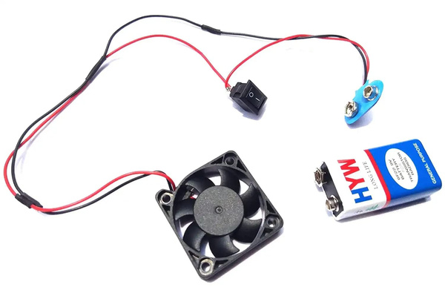
Hardware Components
1
DHT 11 SENSOR
2
ESP 8266 MICROCONTROLLER
A humidity and temperature sensor that provides real-time data to the system.
The brain of the system, responsible for processing sensor data and controlling devices.
3
MOSFET
4
JUMPER WIRES
A semiconductor device that acts as a switch, allowing the microcontroller to control the power flow to devices.
These are used to connect the various components.
5
FANS
6
DIODE
The devices being controlled by the system, providing cooling and ventilation.
A semiconductor device that allows current to flow in only one direction, ensuring the proper flow of electricity.
Notes:
2

Slide 3
Data Flow
Getting Data from Sensor to Arduino IDE
Data Sending from Arduino to ThingsSpeak
Voltage and current sensors measure electrical parameters and transmit data to the Arduino IDE.
The Arduino processes and analyzes the data to identify patterns and anomalies.
Storing and Analyzing Data in ThingsSpeak
Storing Data in Database
Processed data is sent to ThingsSpeak for storage and further analysis.
Data is stored in a database for long-term retention and retrieval.
Calculating Required Fields
Displaying Calculated Results
Required fields such as energy consumption, cost, and efficiency are calculated based on the stored data.
Calculated results are displayed on a user interface, providing insights into energy usage and performance.
Making Adjustments
Controlling Fan Speed
Based on the displayed results, users can adjust energy consumption settings and schedules.
Control signals are sent to the fan to adjust its speed based on the energy management decisions.
Notes:
3

Slide 4
Working of the Project
Sensor Monitoring
Control Unit Adjustment
Fan Speed Regulation
The system monitors the voltage and current supplied to the fan.
The control unit analyzes the data and determines the optimal fan speed based on room temperature and usage.
The system sends control signals to the fan, adjusting its speed to optimize energy consumption.
If the fan is running at high speed but the room is cool, the system can reduce the fan's speed.
By reducing unnecessary fan operation, the system minimizes energy waste.
This ensures that the fan runs efficiently and only when necessary.
Notes:
4

Slide 5
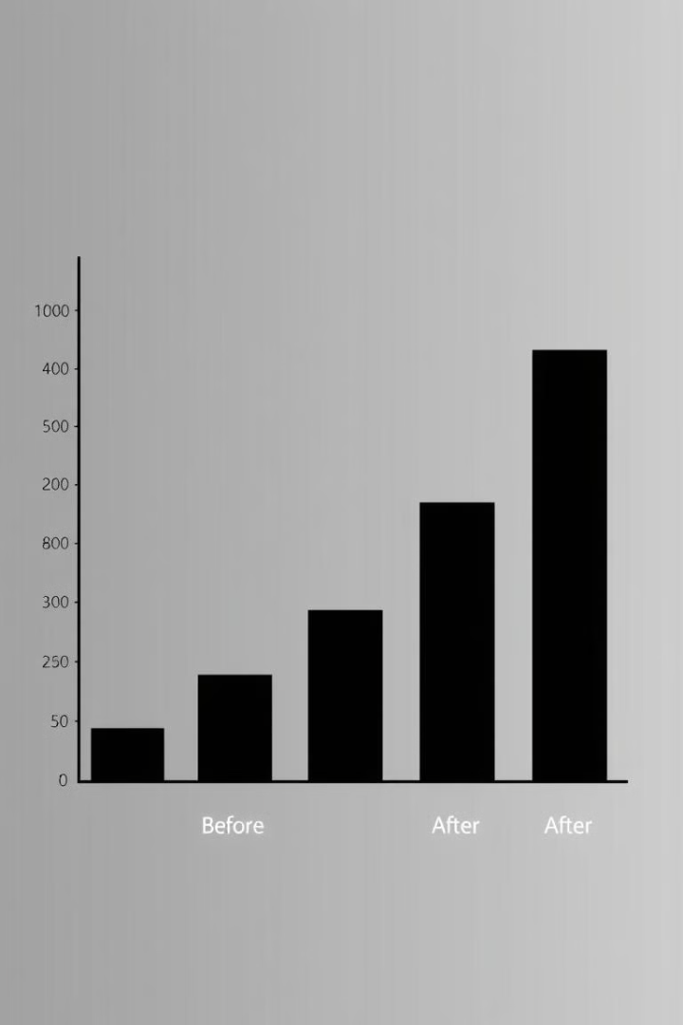
Efficiency
Scenario
Energy Consumption (kWh)
Before System
100
After System
75
The system achieves a 25% reduction in energy consumption by optimizing fan operation and other devices.
The fan speed is regulated according to the surrounding temperature and the energy is consumed efficiently.
Notes:
5

Slide 6
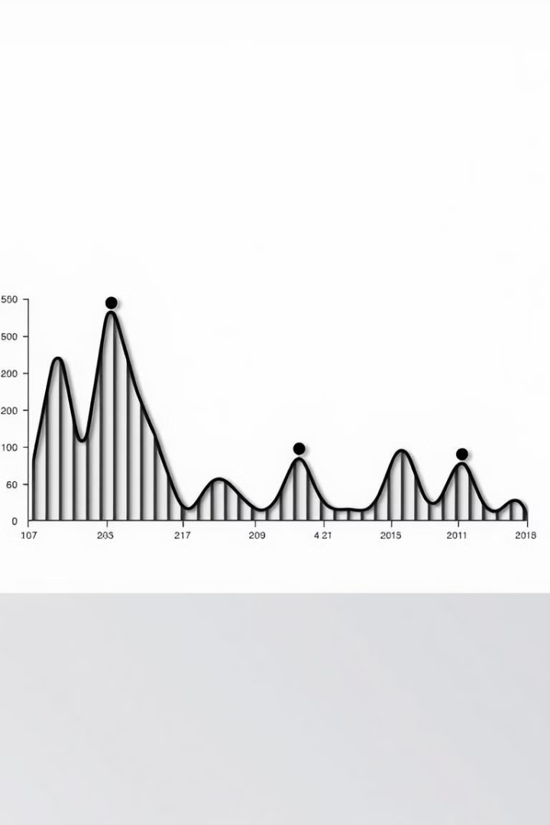



Graphs
Real-time Monitoring
The system provides real-time data visualization of energy consumption.
Trend Analysis
Identify patterns and trends in energy usage to optimize resource allocation.
Historical Data
Track energy consumption over time to identify areas for improvement.
Notes:
6

Slide 7



Energy Saving
Sensor Monitoring
Data Analysis
The system leverages sensors to monitor energy consumption in real-time, identifying opportunities for optimization and reducing unnecessary energy waste.
By providing data-driven insights, the system empowers residents to make informed decisions about their energy usage, contributing to a more sustainable urban environment.
Notes:
7

